Slide 1
Database model for Music Streaming Service
Luka Trunić - 2021230020

Slide 2
CONTENTS
I BUSINESS DESCRIPTION
II BUSINESS RULES
III ENTITY RELATIONSHIP DIAGRAM
IV CRUD ANALYSIS
V APEX IMPLEMENTATION
VI CONCLUSION

Slide 3
I Business description
Primary goal of this platform is for users to discover, listen to, and manage music collection that is available on the app.
Two features:
Free plan: Ad-supported access with standard audio quality
Premium plan: Subscription fee for no advertisements and high-quality audio
This database contains good selection of music from artists from all over the world and people can also share their music by being an artist on the app.
Users can manage and share their playlists that they create on the app, and add and delete the songs that they want on their playlist.

Slide 4
II BUSINESS RULES
Each USER may have one SUBSCRIPTION at a time, and a SUBSCRIPTION may have multiple USERS, depending on the SUBSCRIPTION plan that supports multiple devices or user profiles.
Every USER is categorized as either a FREEUSER or a PREMIUMUSER.
FREEUSER may access content with advertisements, as indicated by their ad preference.
PREMIUMUSER have access to additional features such as ad-free listening and exclusive content, as detailed by their payment method and renewal date or user profiles.
Each USER must own one LIBRARY, which is a collection of PLAYLISTS and SONGS and the LIBRARY is updated every time a new PLAYLIST is added or modified
A LIBRARY may contain multiple PLAYLISTS, but each PLAYLIST is uniquely associated with one LIBRARY.

Slide 5
PLAYLISTS are comprised of multiple SONGS, but a single SONG may appear in multiple PLAYLISTS and this is managed through the PLAYLISTSONG intersection entity.
USERS may have direct access to SONGS independently of PLAYLISTS through the USERSONG intersection entity. This setup allows for tracking user-specific interactions with individual songs, such as play counts, likes, or custom tagging.
Each SONG is linked to exactly one ALBUM, but an ALBUM may contain multiple SONGS. A SONG’s attributes include its genre, duration, and release date, which are inherited from the ALBUM level if not specified individually.
ALBUMS are associated with one ARTIST, though an ARTIST may have multiple ALBUMS.
USER interactions with the platform, such as SONG plays and PLAYLIST modifications, are recorded in the HISTORY entity. Each record in the HISTORY is linked to one USER and includes a timestamp for when the activity occurred.

Slide 6
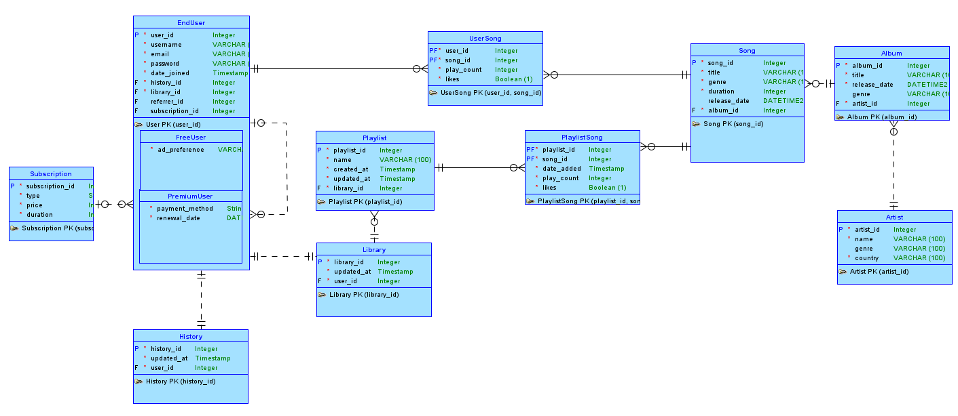
IiI entity relationship diagram

Slide 7
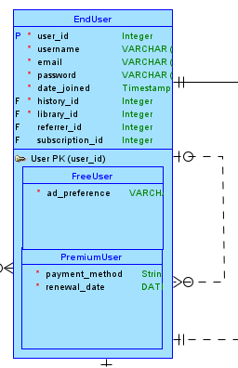
1:m recursive relationship
The USER entity has a recursive 1:M relationship with itself and it creates a FK named “referrer_id”
The FK indicates who referred this user to the service, making it possible to create a referral system where users can invite others.
This setup allows to track user-to-user relationships within the same entity without needing to create an additional entity, keeping the database schema simpler and more direct.

Slide 8
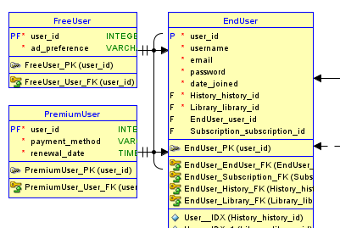
1:m xor relationship (arc)
Both FREEUSER and PREMIUMUSER entities are examples of subtype entities in a relationship where they inherit the primary key “user_id” and other attributes from the USER entity.
This relationship is called 1:M XOR relationship represented by an arc.

Slide 9
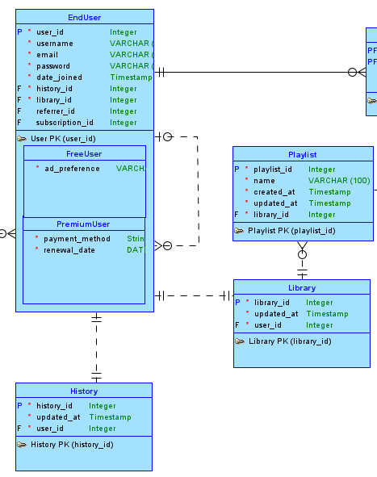
1:1 relationship
User must have a HISTORY of the music that have been played on his account and also a LIBRARY where he saves all his playlists or songs that the user likes or listens to.
This is a 1:1 relationship and both are mandatory because they are both made right after the user makes the account.

Slide 10
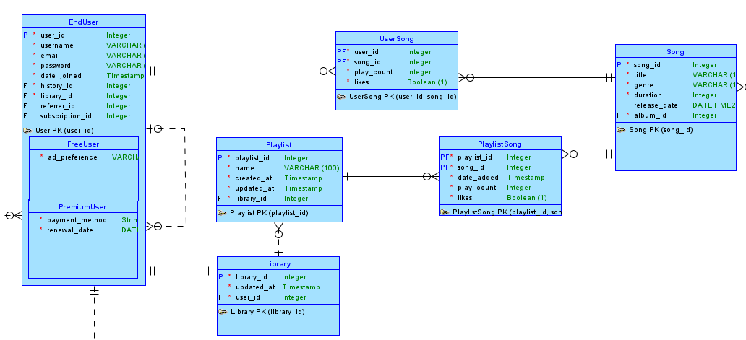
M:n relationship
USERSONG and PLAYLISTSONG entities are called intersection entities, and they resolve a M:N relationship.
By separating the many-to-many relationships into two one-to-many relationships, the design allows more flexibility in managing, querying, and maintaining the database. It becomes easier to add or modify relationships without affecting the primary entities.

Slide 11
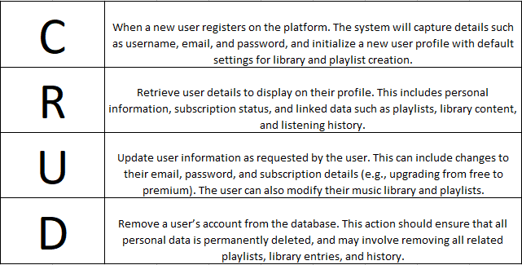
IV CRUD ANALYSIS

Slide 12
V apex implementation
Table Mapping:
1. Key type:
PK – primary key
FK – foreign key
2. Optionality:
*- mandatory
o - optional

Slide 13
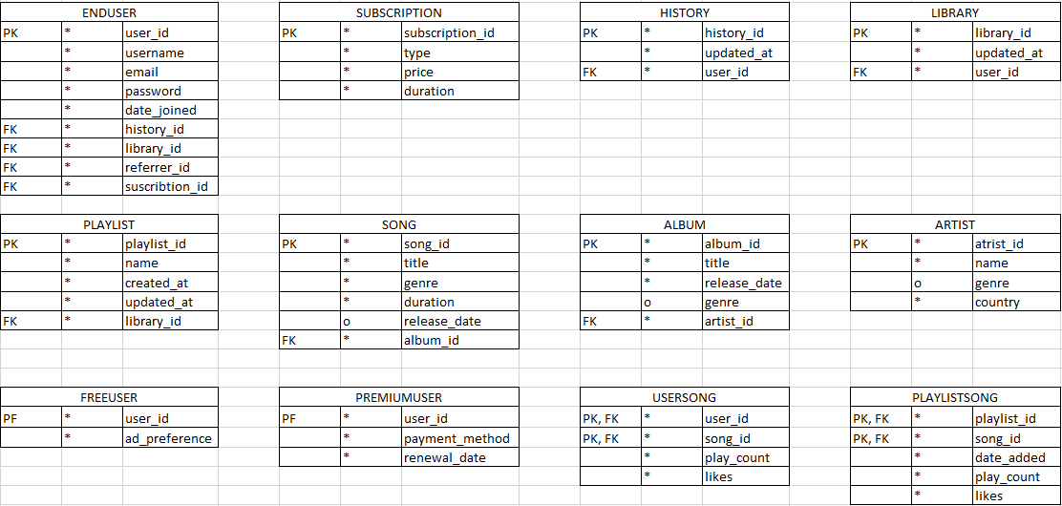

Slide 14
Creating tables (DDL – Data Definition Language)
DDL is a subset of SQL (Structured Query Language) used to define, modify, and manage the schema and structure of a database. It includes commands that allow database administrators and developers to create, alter, and delete database objects such as tables, indexes, constraints, and schemas.
By defining tables and relationships with constraints, DDL helps maintain data integrity. Constraints include primary keys, foreign keys, unique keys, and checks that ensure data adheres to specified rules.

Slide 15
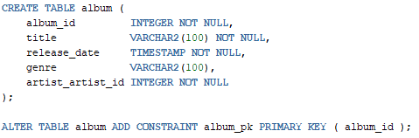
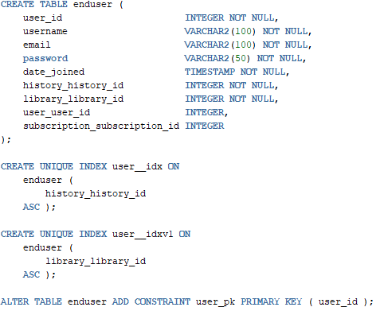
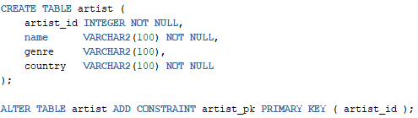
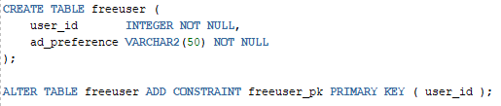
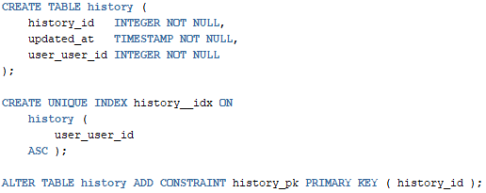
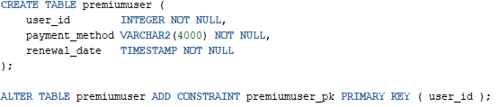

Slide 16
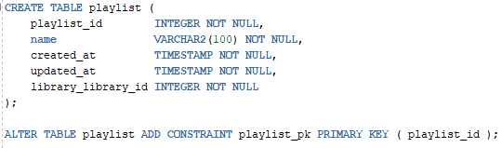
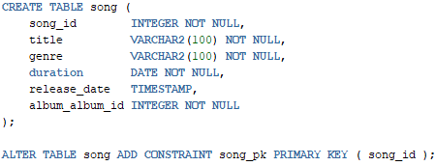
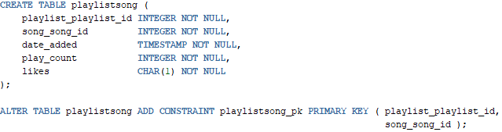
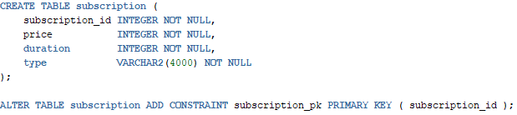
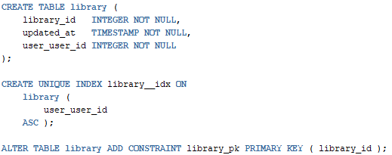
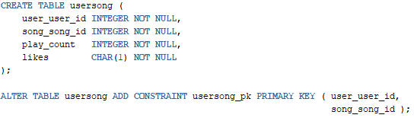

Slide 17
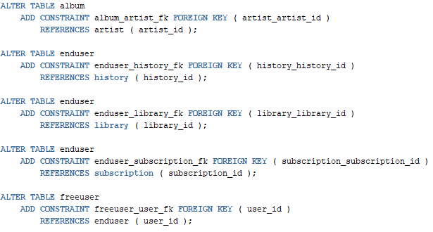
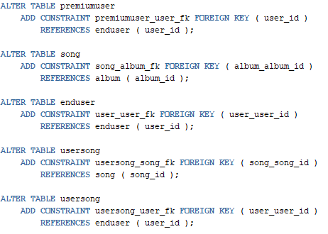
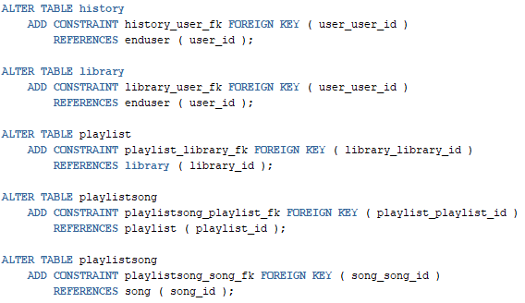

Slide 18
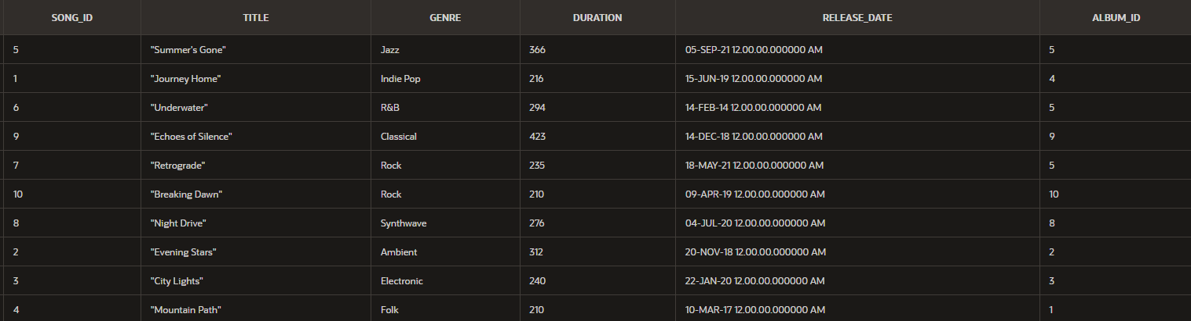
Table sample: song

Slide 19

Query 1: Retrieve All Songs in a Specific Album

Slide 20

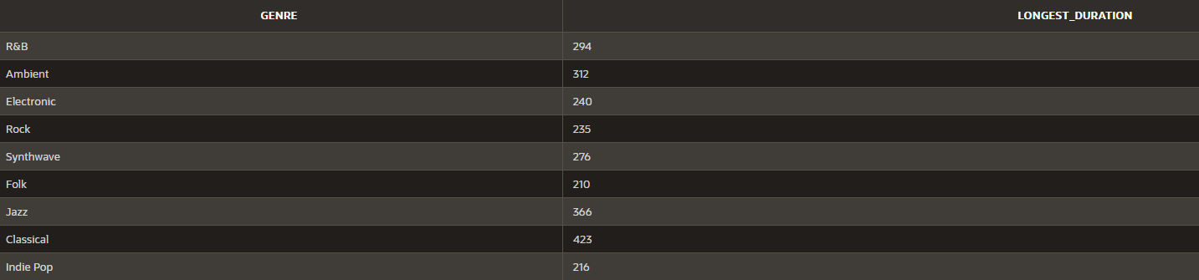
Query 2: Find the Longest Song in Each Genre

Slide 21

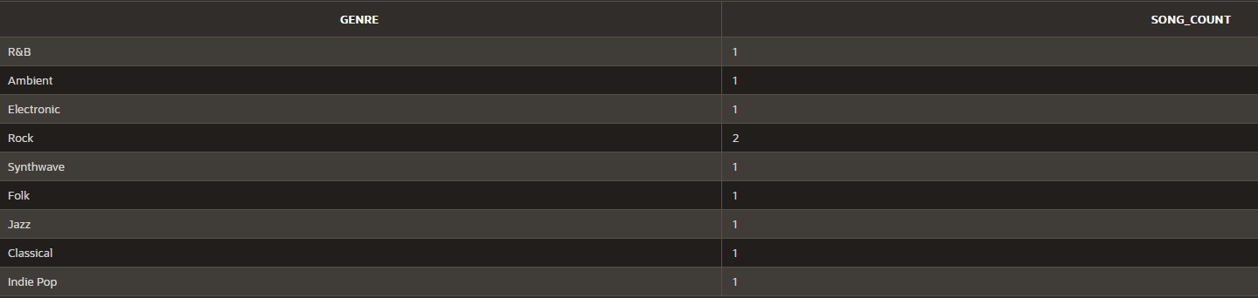
Query 3: Count the Number of Songs by Genre

Slide 22

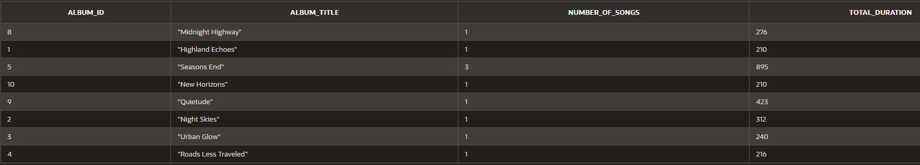
Query 4: List All Albums with Their Songs and Total Play Time

Slide 23
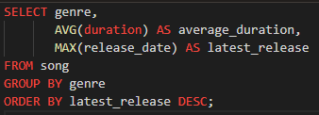
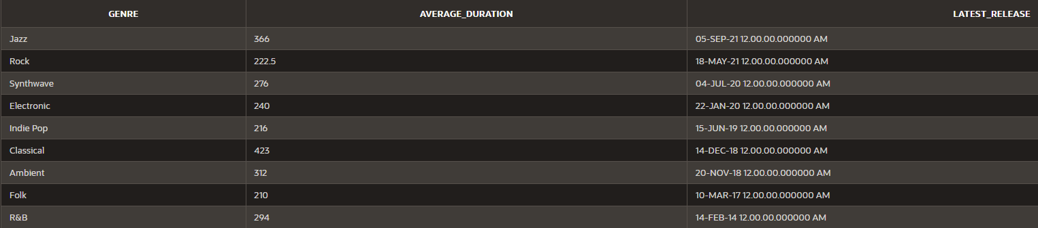
Query 5: Average Duration and Most Recent Release by Genre

Slide 24
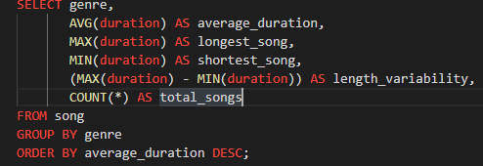
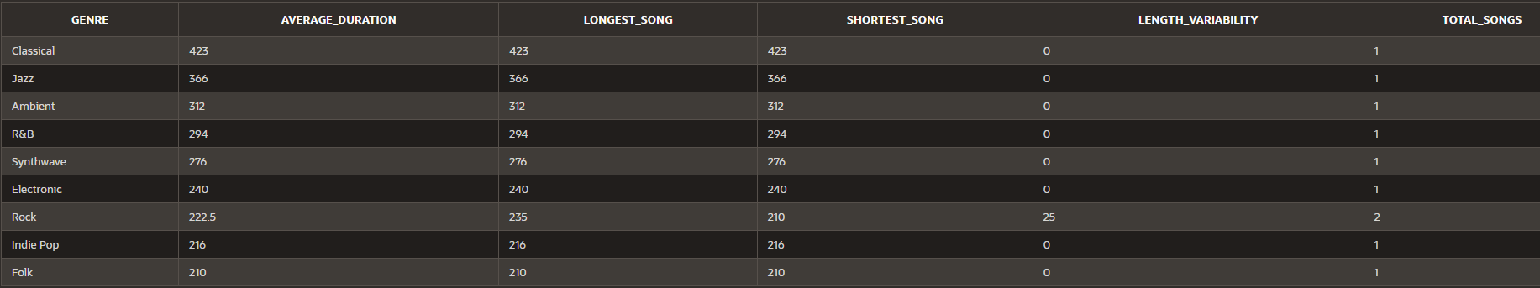
Query 6: Song Length Variability and Maximum Average Duration by Genre

Slide 25
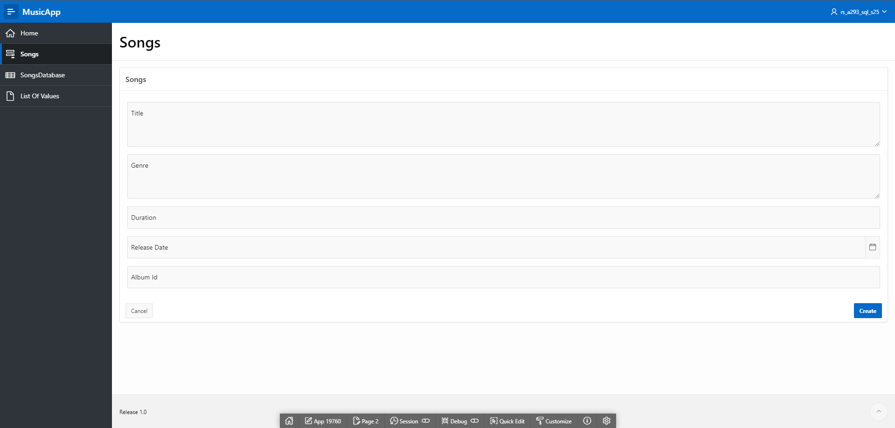
Movie app - form

Slide 26
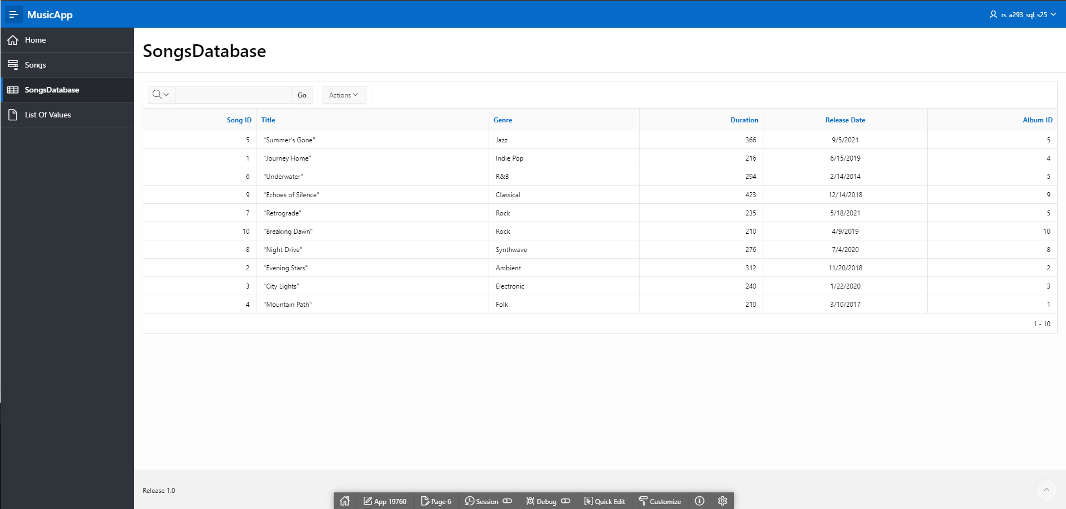
Movie app - report

Slide 27
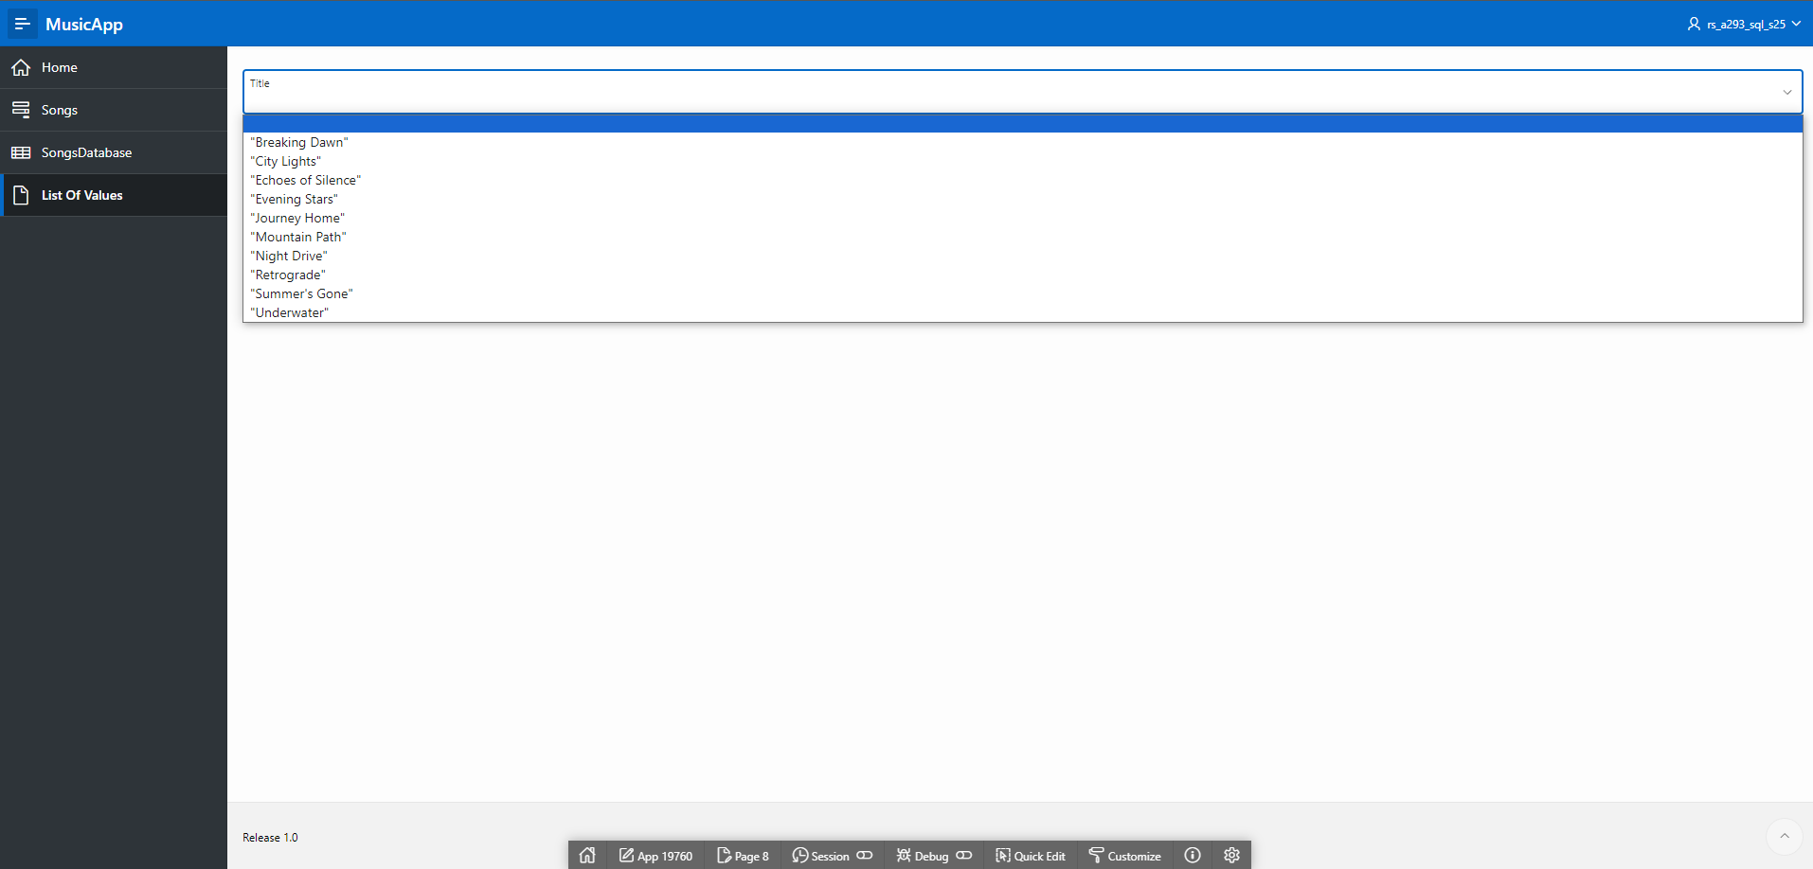
LOV example

Slide 28
VI conclusion
The project to design a database for a music streaming service is successful in establishing a framework capable of managing user interactions, song data, and artist information through a well-structured ERD and efficient data handling via Oracle APEX. The implementation of business rules and CRUD analysis provides flexibility and functionality to user needs.
Main limitation of this project is that the volume of data is high and it continues to grow every day, and this current database schema will require optimization to handle the data. Also, this current setup is not optimized for real-time data for features like live song recommendations, which is crucial for this app.

Slide 29
THANK YOU!!! ☺

